Slide 1
<DATA STRUCTURES AND ALGORITHM>

Slide 2
V. TREE

Slide 3
TREE
A tree is a data structure similar to a linked list but instead of each node pointing simply to the next node in a linear fashion, each node points to a number of nodes. Tree is an example of a nonlinear data structure. A tree structure is a way of representing the hierarchical nature of a structure in a graphical form.
In trees ADT (Abstract Data Type), the order of the elements is not important. If we need ordering information, linear data structures like linked lists, stacks, queues, etc. can be used.

Slide 4
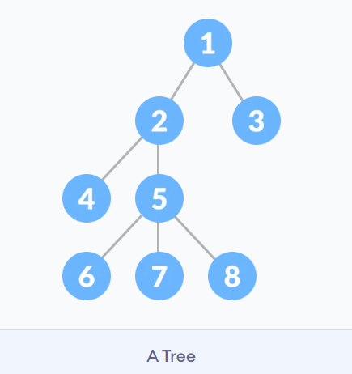
TREE

Slide 5
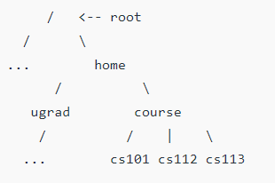
WHY TREE DATA STRUCTURE ?
One reason to use trees might be because you want to store information that naturally forms a hierarchy. For example, the file system on a computer:

Slide 6
WHY TREE DATA STRUCTURE ?
Other data structures such as arrays, linked list, stack, and queue are linear data structures that store data sequentially. In order to perform any operation in a linear data structure, the time complexity increases with the increase in the data size. But, it is not acceptable in today's computational world.
Different tree data structures allow quicker and easier access to the data as it is a non-linear data structure.

Slide 7
WHY TREE DATA STRUCTURE ?
Other data structures such as arrays, linked list, stack, and queue are linear data structures that store data sequentially. In order to perform any operation in a linear data structure, the time complexity increases with the increase in the data size. But, it is not acceptable in today's computational world.
Different tree data structures allow quicker and easier access to the data as it is a non-linear data structure.

Slide 8
TREE TERMINOLOGY
Node
A node is an entity that contains a key or value and pointers to its child nodes.
The last nodes of each path are called leaf nodes or external nodes that do not contain a link/pointer to child nodes.
The node having at least a child node is called an internal node.
Edge
It is the link between any two nodes.

Slide 9
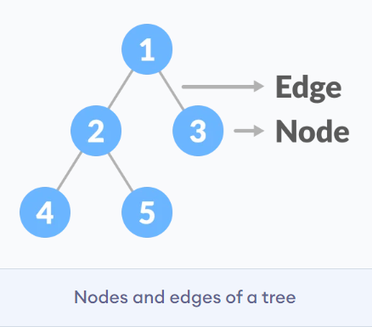
TREE TERMINOLOGY

Slide 10
TREE TERMINOLOGY
Node
A node is an entity that contains a key or value and pointers to its child nodes.
The last nodes of each path are called leaf nodes or external nodes that do not contain a link/pointer to child nodes.
The node having at least a child node is called an internal node.
Edge
It is the link between any two nodes.

Slide 11
TREE TERMINOLOGY
Root - It is the topmost node of a tree.
Parent − Any node except the root node has one edge upward to a node called parent.
Child − The node below a given node connected by its edge downward is called its child node.
Leaf − The node which does not have any child node is called the leaf node.
Subtree − Subtree represents the descendants of a node.
Depth of a Node - The depth of a node is the number of edges from the root to the node.

Slide 12
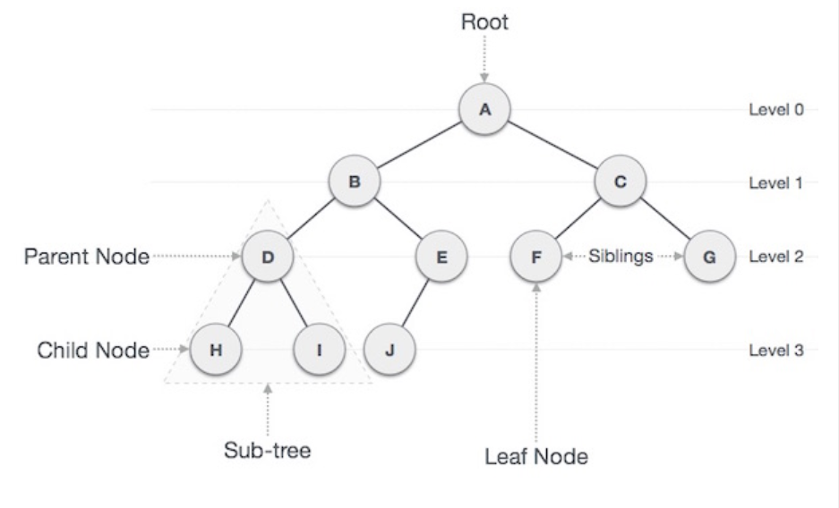
TREE TERMINOLOGY

Slide 13
TYPES OF TREE
Binary Search Tree
AVL Tree
B-Tree

Slide 14
OTHER APPLICATIONS OF TREE
Store hierarchical data, like folder structure, organization structure, XML/HTML data.
Binary Search Tree is a tree that allows fast search, insert, delete on a sorted data. It also allows finding closest item
Heap is a tree data structure which is implemented using arrays and used to implement priority queues.
B-Tree and B+ Tree : They are used to implement indexing in databases.
Decision trees.
Organization chart of a large organization.

Slide 15
BINARY SEARCH TREE (BST)
Binary search tree is a data structure that quickly allows us to maintain a sorted list of numbers.
It is called a binary tree because each tree node has a maximum of two children.
It is called a search tree because it can be used to search for the presence of a number in O(log(n)) time.

Slide 16
PROPERTIES OF A BST
The properties that separate a binary search tree from a regular binary tree is:
All nodes of left subtree are less than the root node
All nodes of right subtree are more than the root node
Both subtrees of each node are also BSTs i.e. they have the above two properties

Slide 17
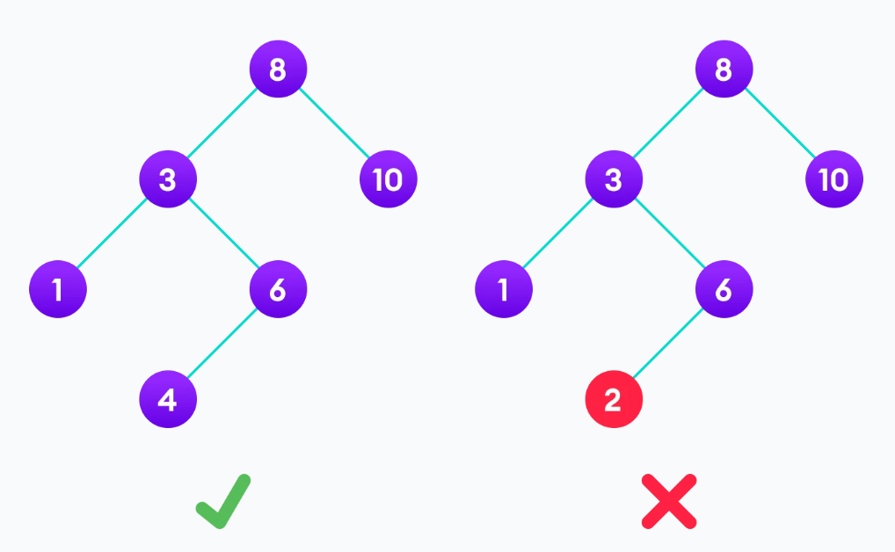
A BINARY SEARCH TREE

Slide 18
BASIC BST OPERATIONS
The basic operations that can be performed on a binary search tree data structure, are the following:
Preorder Traversal − Traverses a tree in a pre-order manner.
Inorder Traversal − Traverses a tree in an in-order manner.
Postorder Traversal − Traverses a tree in a post-order manner.
Insert − Inserts an element in a tree/create a tree.
Search − Searches an element in a tree.

Slide 19
TREE TRAVERSAL
Traversing a tree means visiting every node in the tree. You might, for instance, want to add all the values in the tree or find the largest one. For all these operations, you will need to visit each node of the tree.
Linear data structures like arrays, stacks, queues, and linked list have only one way to read the data. But a hierarchical data structure like a tree can be traversed in different ways.

Slide 20
INORDER TRAVERSAL
First, visit all the nodes in the left subtree
Then the root node
Visit all the nodes in the right subtree
Inorder (Left, Root, Right)

Slide 21
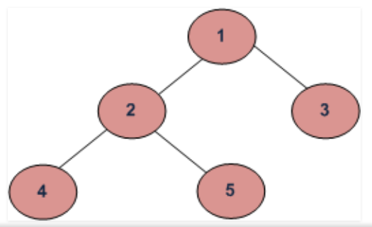
INORDER TRAVERSAL
Recall that the order for inorder traversal is Left, Root, Right: 4 2 5 1 3

Slide 22
PREORDER TRAVERSAL
Visit root node
Visit all the nodes in the left subtree
Visit all the nodes in the right subtree
Preorder (Root, Left, Right)

Slide 23
PREORDER TRAVERSAL
Preorder (Root, Left, Right) : 1 2 4 5 3

Slide 24
POSTORDER TRAVERSAL
Visit all the nodes in the left subtree
Visit all the nodes in the right subtree
Visit the root node
Postorder (Left, Right, Root)

Slide 25
POSTORDER TRAVERSAL
Postorder (Left, Right, Root) : 4 5 2 3 1

Slide 26
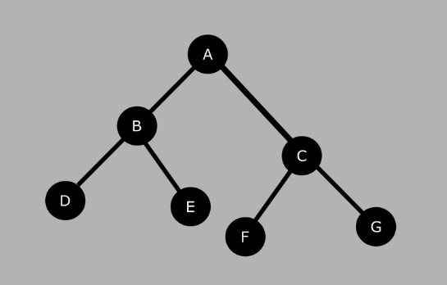
EXERCISES ON TRAVERSAL
Eg: treetraversal.c

Slide 27
REFERENCES
Data Structures And Algorithms Made Easy: Data Structures And Algorithmic Puzzles by Narasimha Karumanchi
https://www.programiz.com/
https://www.geeksforgeeks.org/
https://www.tutorialspoint.com/

